Slide 1
CISE301: Numerical Methods
Topic 4:
Least Squares Curve Fitting
Lectures 18-19:
KFUPM
Read Chapter 17 of the textbook
CISE301_Topic4

Slide 2
Lecture 18
Introduction to Least Squares
CISE301_Topic4

Slide 3
Motivation
Given a set of experimental data:
x | 1 | 2 | 3
y | 5.1 | 5.9 | 6.3
The relationship between x and y may not be clear.
Find a function f(x) that best fit the data
1 2 3
CISE301_Topic4

Slide 4
Motivation
In engineering, two types of applications are encountered:
  Trend analysis: Predicting values of dependent variable, may include extrapolation beyond data points or interpolation between data points.
  Hypothesis testing: Comparing existing mathematical model with measured data.
What is the best mathematical function f that represents the dataset?
What is the best criterion to assess the fitting of the function f to the data?
CISE301_Topic4

Slide 5
Curve Fitting
Given a set of tabulated data, find a curve or a function that best represents the data.
Given:
    The tabulated data
    The form of the function
    The curve fitting criteria
Find the unknown coefficients
CISE301_Topic4

Slide 6
Least Squares Regression
Linear Regression
‌Fitting a straight line to a set of paired observations:
(x₁, y₁), (x₂, y₂),…,(x_{n}, y_{n}).
y=a₀+a₁x+e
a₁-slope.
a₀-intercept.
e-error, or residual, between the model and the observations.
CISE301_Topic4

Slide 7
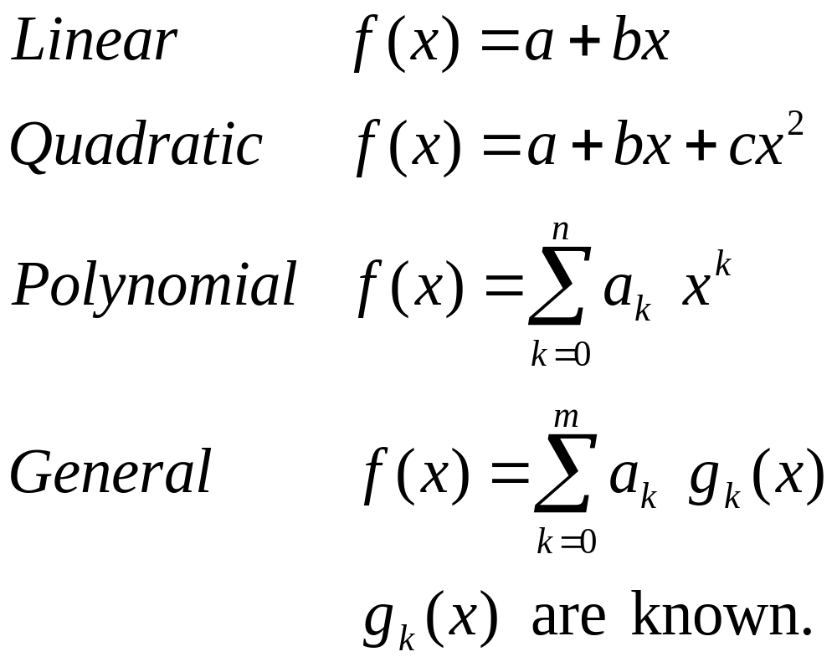
Selection of the Functions
CISE301_Topic4

Slide 8
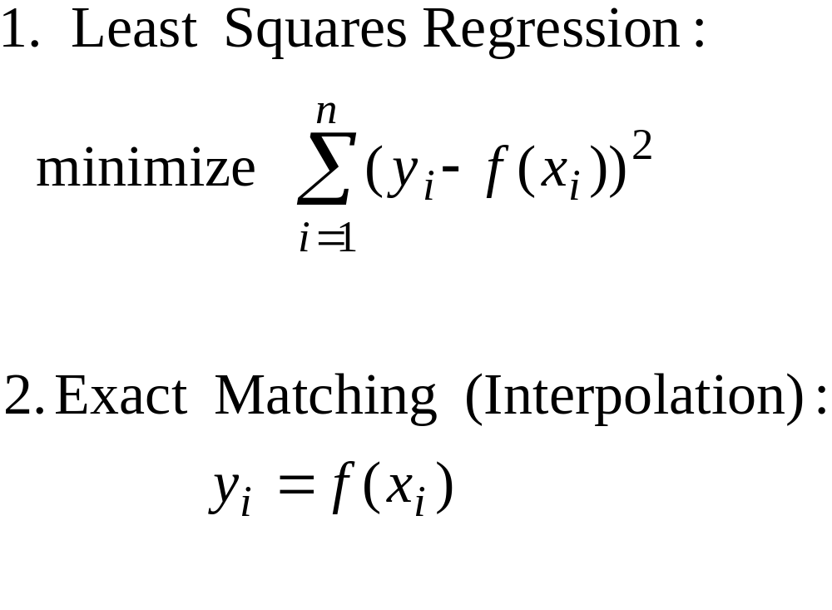
Decide on the Criterion
Chapter 17
Chapter 18
CISE301_Topic4

Slide 9
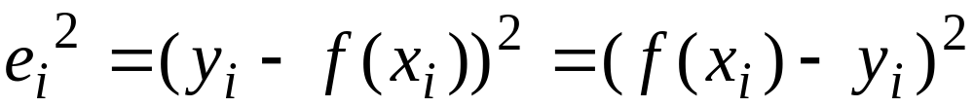
Least Squares Regression
Given:
x_{i} | x₁ | x₂ | …. | x_{n}
y_{i} | y₁ | y₂ | …. | y_{n}
The form of the function is assumed to be known but the coefficients are unknown.
The difference is assumed to be the result of experimental error.
CISE301_Topic4

Slide 10
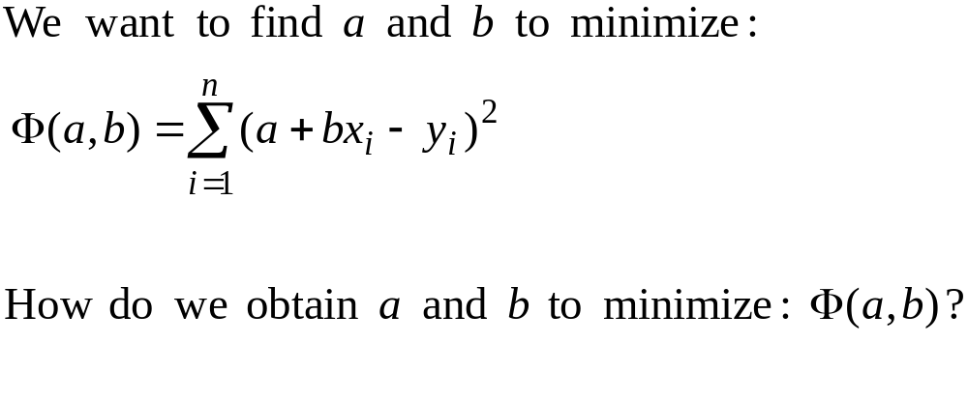
Determine the Unknowns
CISE301_Topic4

Slide 11
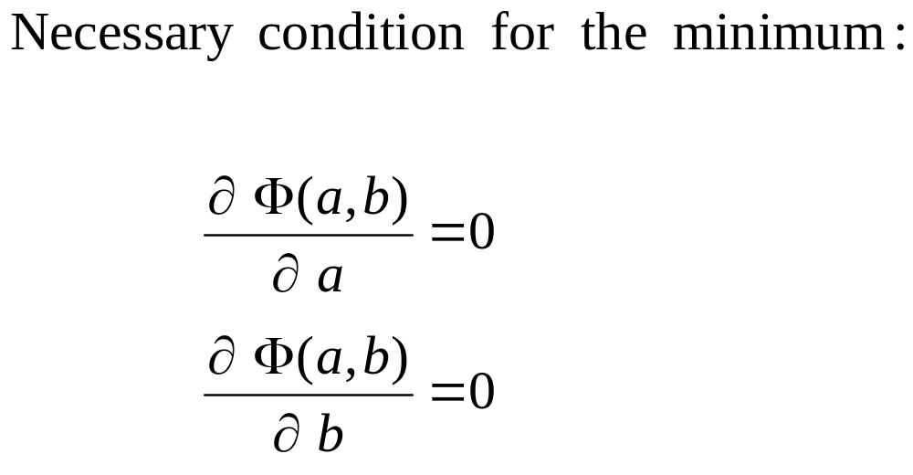
Determine the Unknowns
CISE301_Topic4

Slide 12
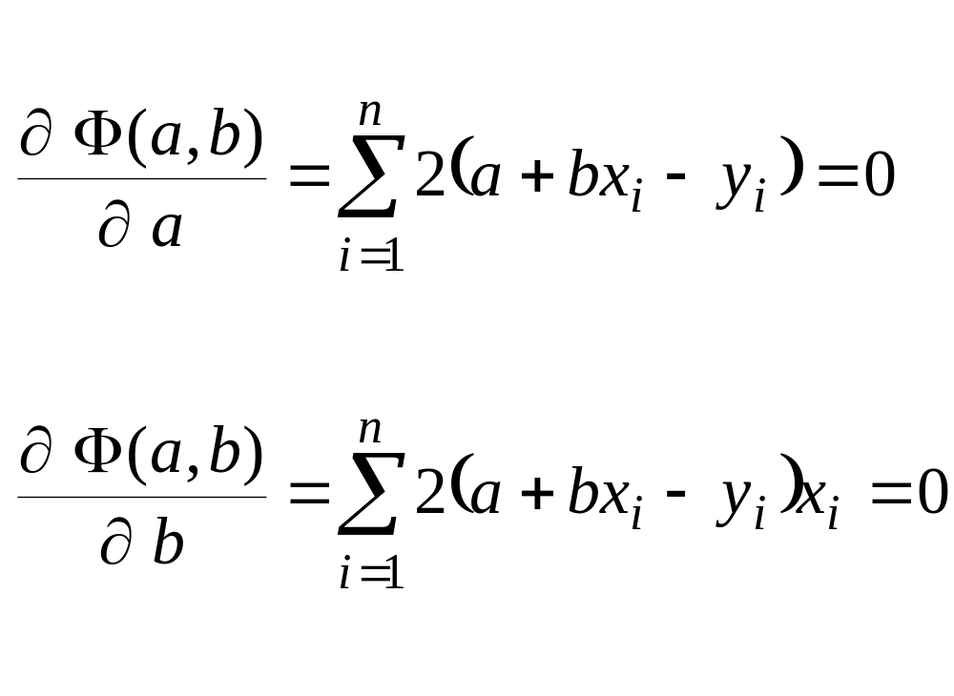
Determining the Unknowns
CISE301_Topic4

Slide 13
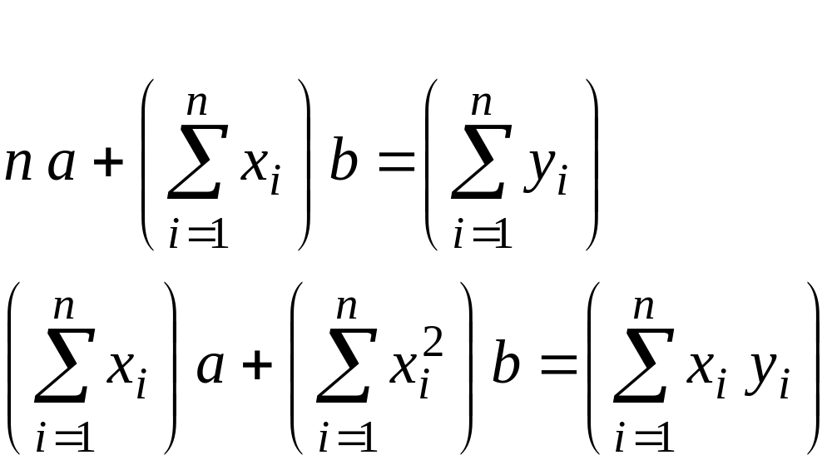
Normal Equations
CISE301_Topic4

Slide 14
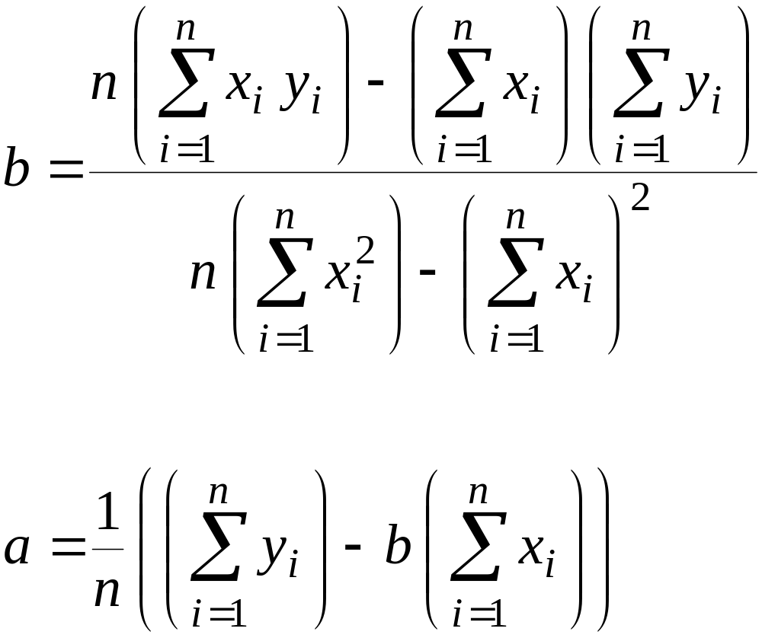
Solving the Normal Equations
CISE301_Topic4

Slide 15
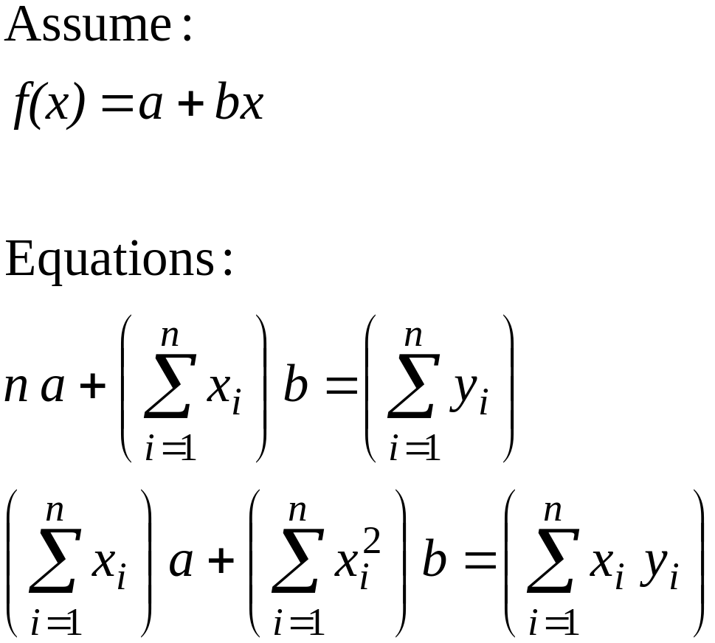
Example 1: Linear Regression
x | 1 | 2 | 3
y | 5.1 | 5.9 | 6.3
CISE301_Topic4

Slide 16
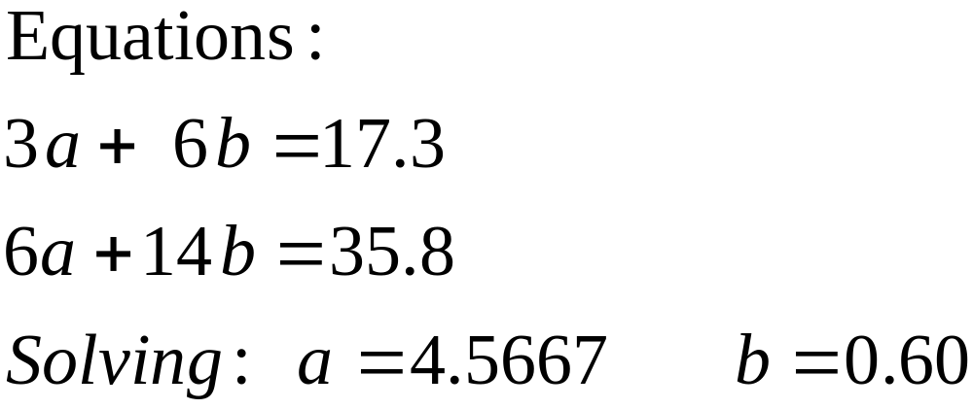
Example 1: Linear Regression
i | 1 | 2 | 3 | sum
x_{i} | 1 | 2 | 3 | 6
y_{i} | 5.1 | 5.9 | 6.3 | 17.3
x_{i}² | 1 | 4 | 9 | 14
x_{i} y_{i} | 5.1 | 11.8 | 18.9 | 35.8
CISE301_Topic4

Slide 17
Multiple Linear Regression
t | 0 | 1 | 2 | 3
x | 0.1 | 0.4 | 0.2 | 0.2
y | 3 | 2 | 1 | 2
Example:
Given the following data:
Determine a function of two variables:
f(x,t) = a + b x + c t
That best fits the data with the least sum of the square of errors.
CISE301_Topic4

Slide 18

Solution of Multiple Linear Regression
Construct , the sum of the square of the error and derive the necessary conditions by equating the partial derivatives with respect to the unknown parameters to zero, then solve the equations.
t | 0 | 1 | 2 | 3
x | 0.1 | 0.4 | 0.2 | 0.2
y | 3 | 2 | 1 | 2
CISE301_Topic4

Slide 19
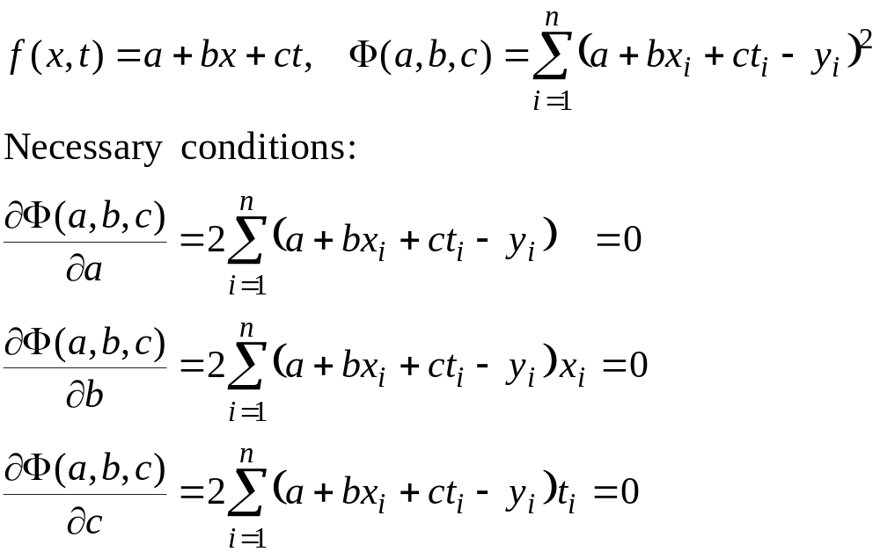
Solution of Multiple Linear Regression
CISE301_Topic4

Slide 20
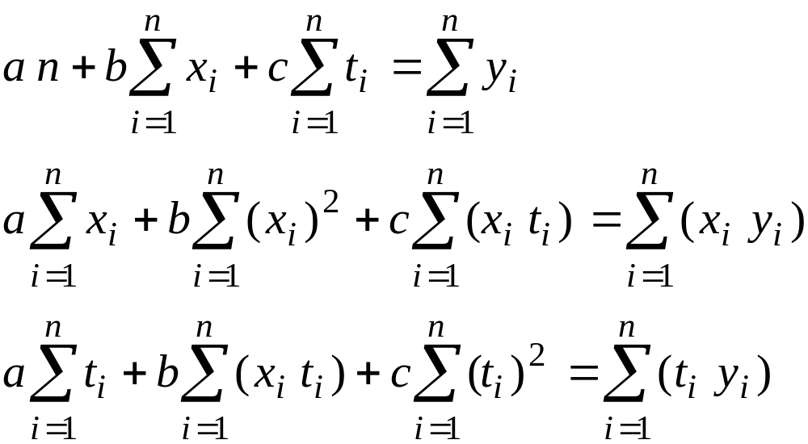
System of Equations
CISE301_Topic4

Slide 21
Example 2: Multiple Linear Regression
i | 1 | 2 | 3 | 4 | Sum
t_{i} | 0 | 1 | 2 | 3 | 6
x_{i} | 0.1 | 0.4 | 0.2 | 0.2 | 0.9
y_{i} | 3 | 2 | 1 | 2 | 8
x_{i}² | 0.01 | 0.16 | 0.04 | 0.04 | 0.25
x_{i} t_{i} | 0 | 0.4 | 0.4 | 0.6 | 1.4
x_{i} y_{i} | 0.3 | 0.8 | 0.2 | 0.4 | 1.7
t_{i}² | 0 | 1 | 4 | 9 | 14
t_{i} y_{i} | 0 | 2 | 2 | 6 | 10
CISE301_Topic4

Slide 22
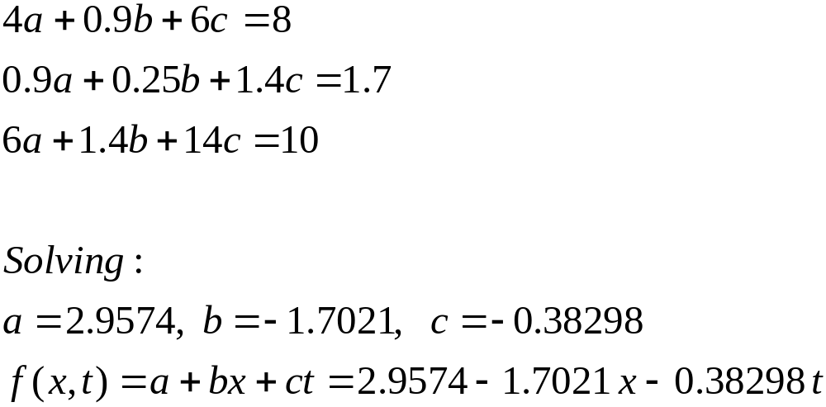
Example 2: System of Equations
CISE301_Topic4

Slide 23
Lecture 19
Nonlinear Least Squares Problems
Examples of Nonlinear Least Squares
Solution of Inconsistent Equations
Continuous Least Square Problems
CISE301_Topic4

Slide 24
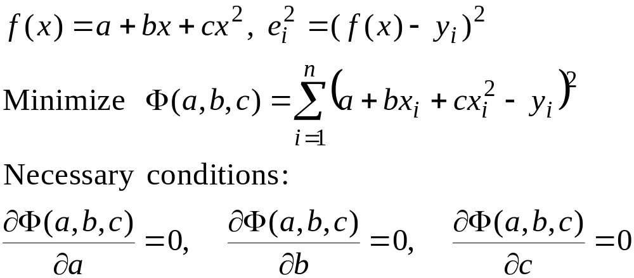
Polynomial Regression
The least squares method can be extended to fit the data to a higher-order polynomial
CISE301_Topic4

Slide 25
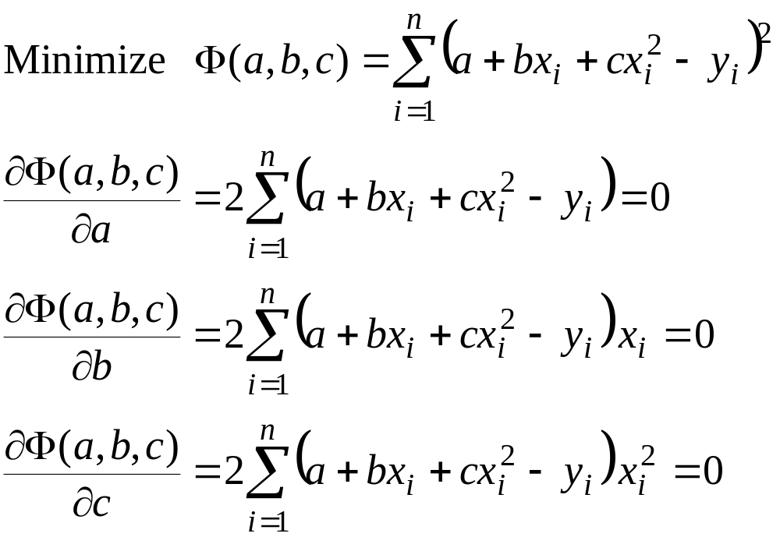
Equations for Quadratic Regression
CISE301_Topic4

Slide 26
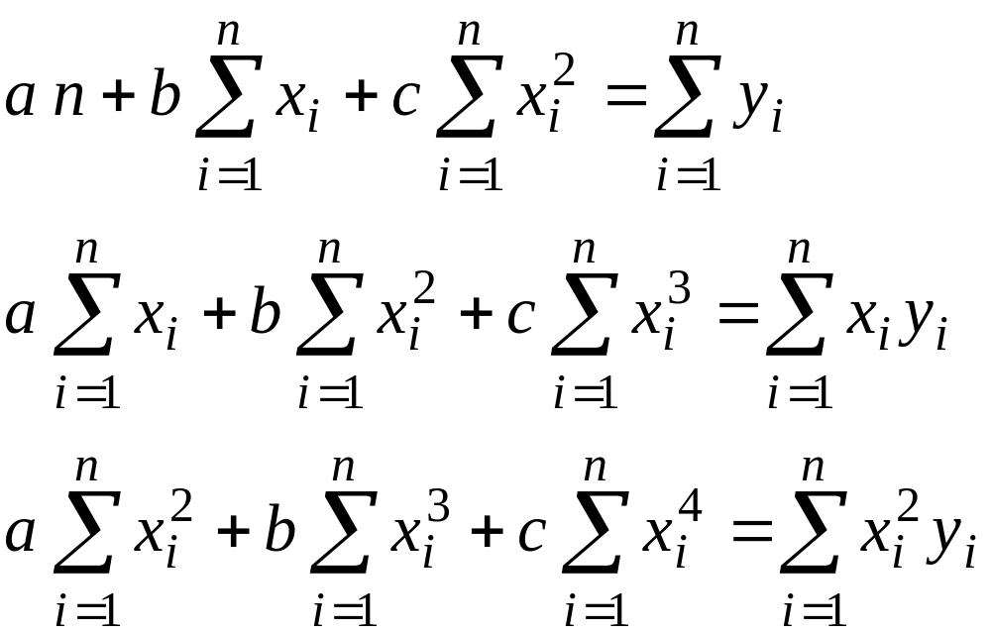
Normal Equations
CISE301_Topic4

Slide 27
Example 3: Polynomial Regression
Fit a second-order polynomial to the following data
x_{i} | 0 | 1 | 2 | 3 | 4 | 5 | ∑=15
y_{i} | 2.1 | 7.7 | 13.6 | 27.2 | 40.9 | 61.1 | ∑=152.6
x_{i}² | 0 | 1 | 4 | 9 | 16 | 25 | ∑=55
x_{i}³ | 0 | 1 | 8 | 27 | 64 | 125 | 225
x_{i}⁴ | 0 | 1 | 16 | 81 | 256 | 625 | ∑=979
x_{i} y_{i} | 0 | 7.7 | 27.2 | 81.6 | 163.6 | 305.5 | ∑=585.6
x_{i}² y_{i} | 0 | 7.7 | 54.4 | 244.8 | 654.4 | 1527.5 | ∑=2488.8
CISE301_Topic4

Slide 28
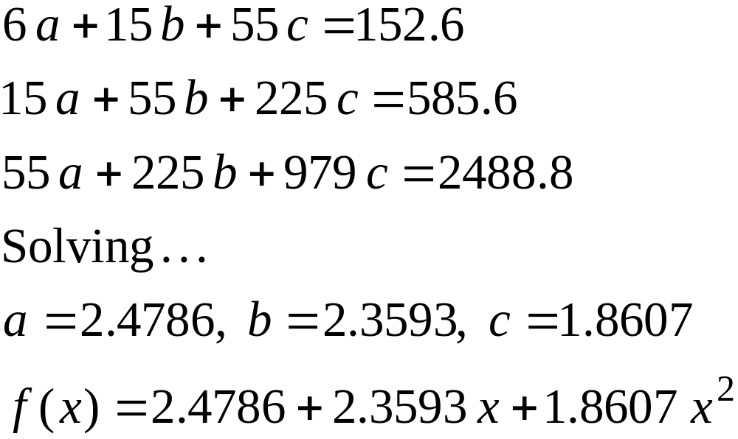
Example 3: Equations and Solution
CISE301_Topic4

Slide 29
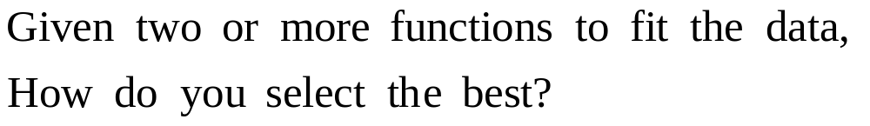
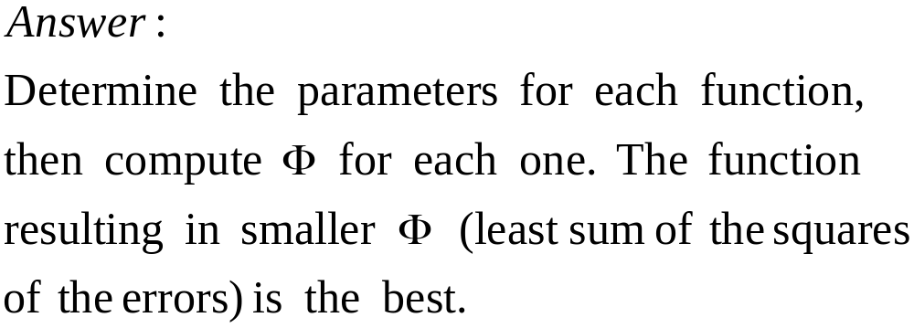
How Do You Judge Functions?
CISE301_Topic4

Slide 30
Example showing that Quadratic is preferable than Linear Regression
y
y
x
x
Linear Regression
Quadratic Regression
CISE301_Topic4

Slide 31
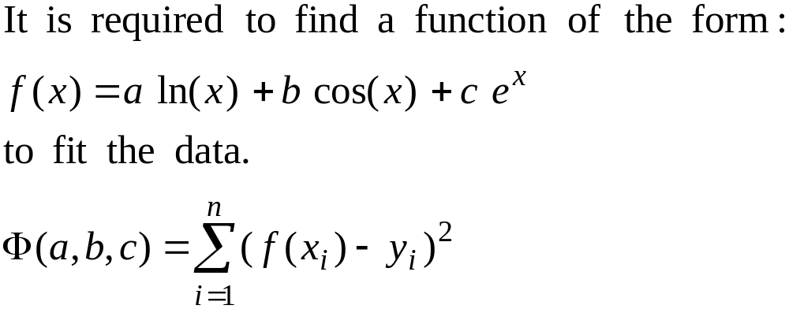
Fitting with Nonlinear Functions
x_{i} | 0.24 | 0.65 | 0.95 | 1.24 | 1.73 | 2.01 | 2.23 | 2.52
y_{i} | 0.23 | -0.23 | -1.1 | -0.45 | 0.27 | 0.1 | -0.29 | 0.24
CISE301_Topic4

Slide 32
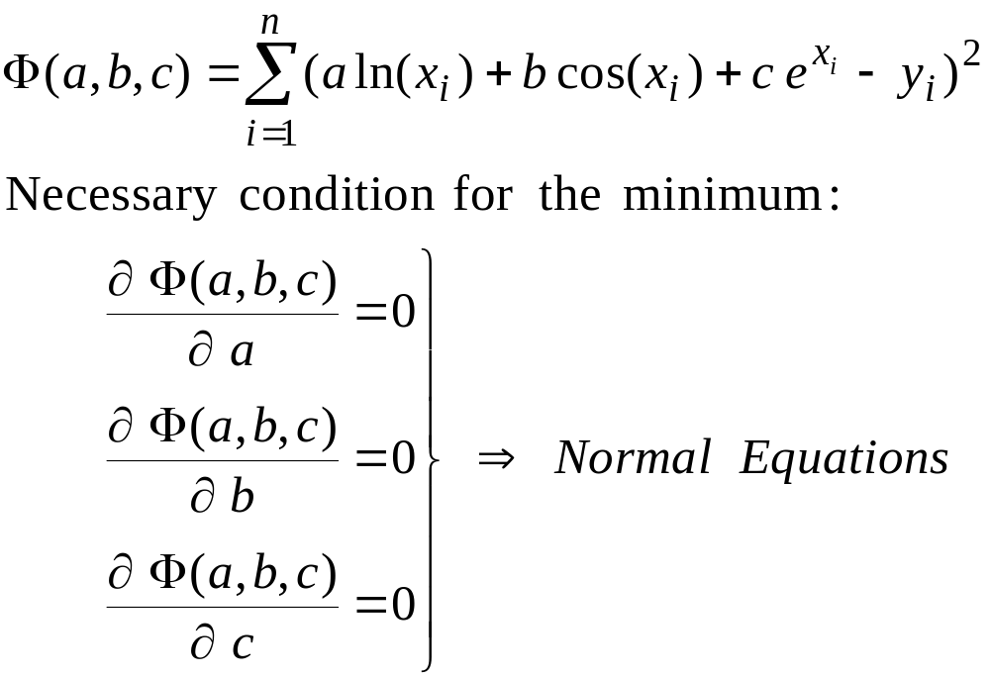
Fitting with Nonlinear Functions
CISE301_Topic4

Slide 33
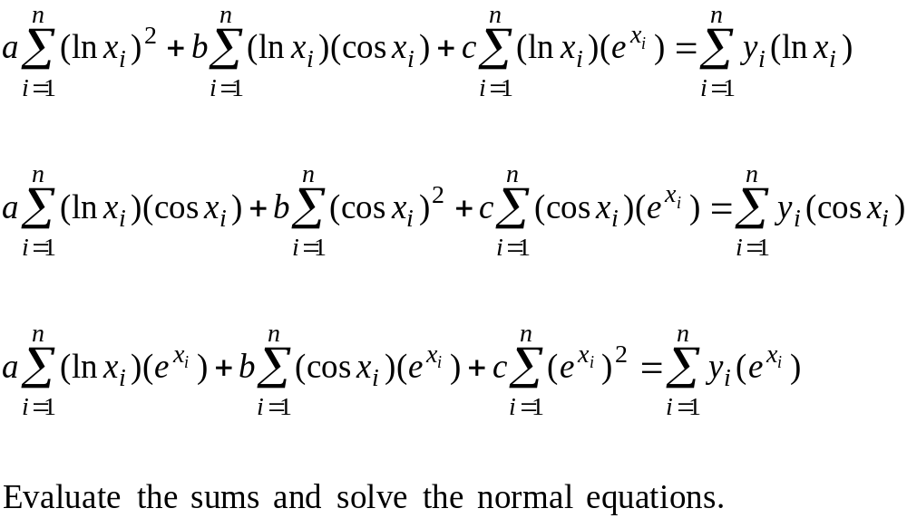
Normal Equations
CISE301_Topic4

Slide 34
Example 4: Evaluating Sums
xi | 0.24 | 0.65 | 0.95 | 1.24 | 1.73 | 2.01 | 2.23 | 2.52 | ∑=11.57
yi | 0.23 | -0.23 | -1.1 | -0.45 | 0.27 | 0.1 | -0.29 | 0.24 | ∑=-1.23
(ln xi)² | 2.036 | 0.1856 | 0.0026 | 0.0463 | 0.3004 | 0.4874 | 0.6432 | 0.8543 | ∑=4.556
ln(xi) cos(xi) | -1.386 | -0.3429 | -0.0298 | 0.0699 | -0.0869 | -0.2969 | -0.4912 | -0.7514 | ∑=-3.316
ln(xi) * e^{xi} | -1.814 | -0.8252 | -0.1326 | 0.7433 | 3.0918 | 5.2104 | 7.4585 | 11.487 | ∑=25.219
yi * ln(xi) | -0.328 | 0.0991 | 0.0564 | -0.0968 | 0.1480 | 0.0698 | -0.2326 | 0.2218 | ∑=-0.0625
cos(xi)² | 0.943 | 0.6337 | 0.3384 | 0.1055 | 0.0251 | 0.1808 | 0.3751 | 0.6609 | ∑=3.26307
cos(xi) * e^{xi} | 1.235 | 1.5249 | 1.5041 | 1.1224 | -0.8942 | -3.1735 | -5.696 | -10.104 | ∑=-14.481
yi*cos(xi) | 0.223 | -0.1831 | -0.6399 | -0.1462 | -0.0428 | -0.0425 | 0.1776 | -0.1951 | ∑=-0.8485
(e^{xi})² | 1.616 | 3.6693 | 6.6859 | 11.941 | 31.817 | 55.701 | 86.488 | 154.47 | ∑=352.39
yi * e^{xi} | 0.2924 | -0.4406 | -2.844 | -1.555 | 1.523 | 0.7463 | -2.697 | 2.9829 | ∑=-1.9923
CISE301_Topic4

Slide 35
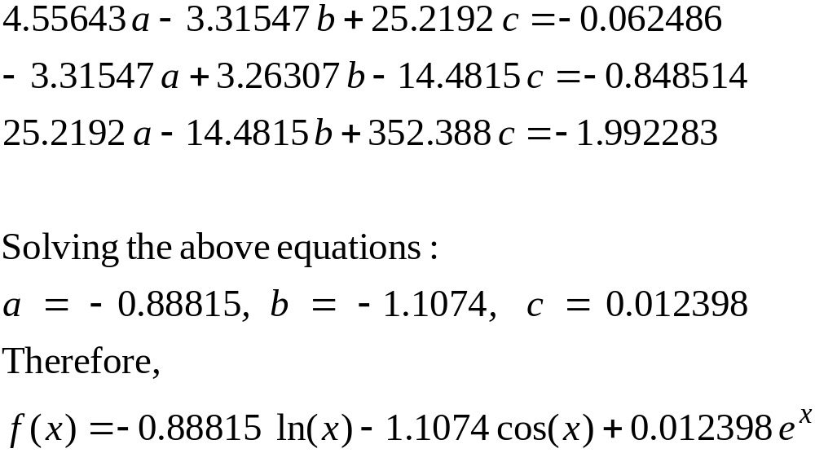
Example 4: Equations & Solution
CISE301_Topic4

Slide 36
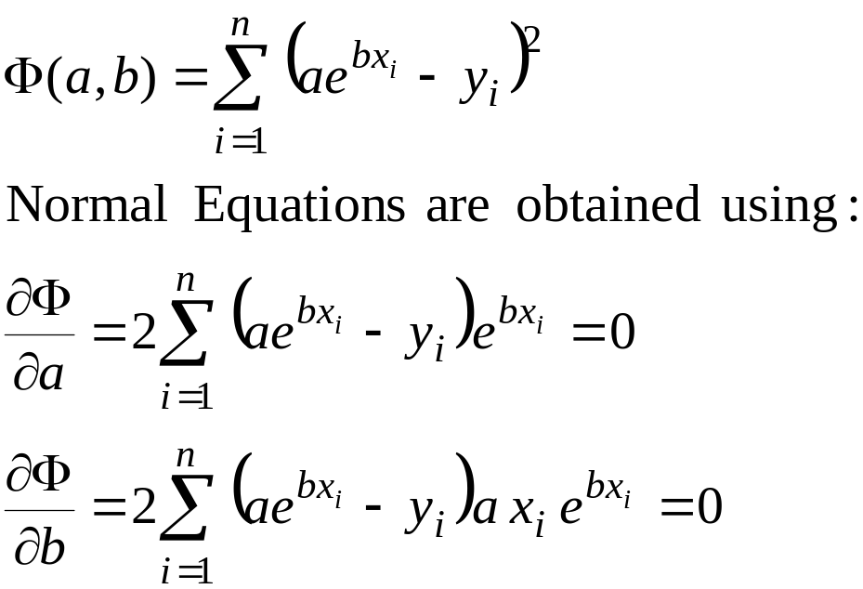
Example 5
x_{i} | 1 | 2 | 3
y_{i} | 2.4 | 5 | 9
Given:
Difficult to Solve
CISE301_Topic4

Slide 37
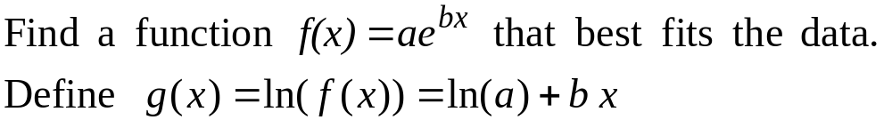
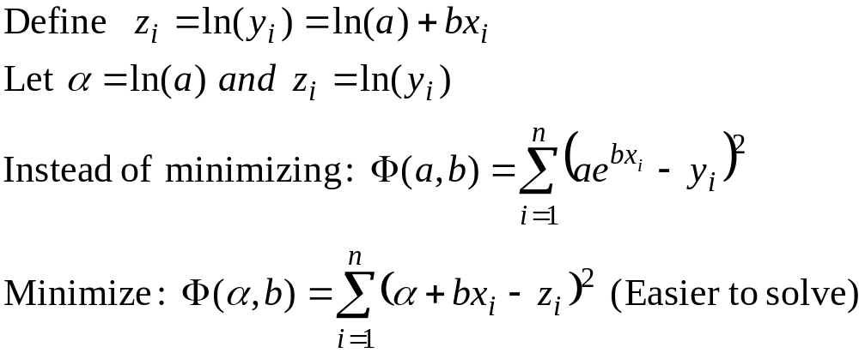
Linearization Method
CISE301_Topic4

Slide 38
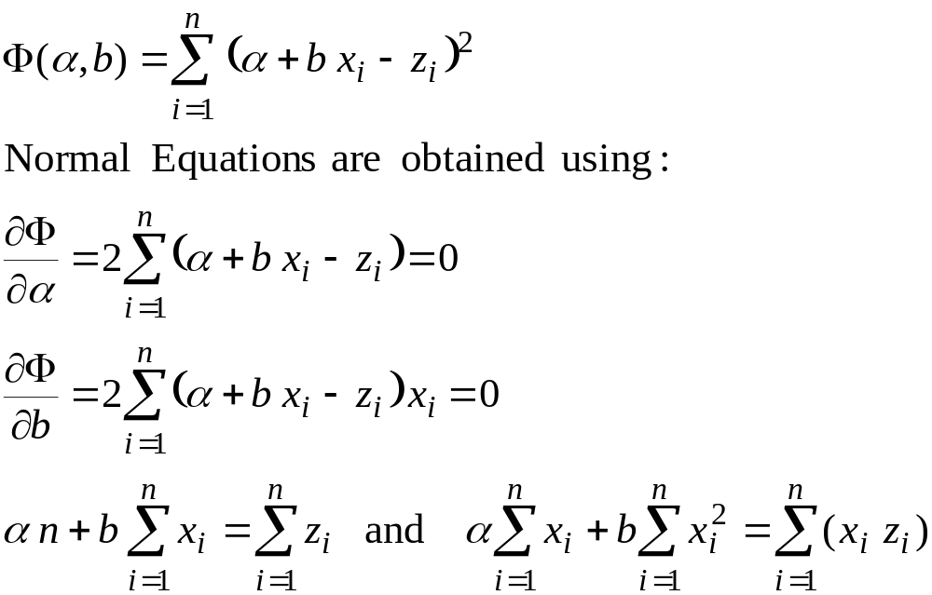
Example 5: Equations
CISE301_Topic4

Slide 39
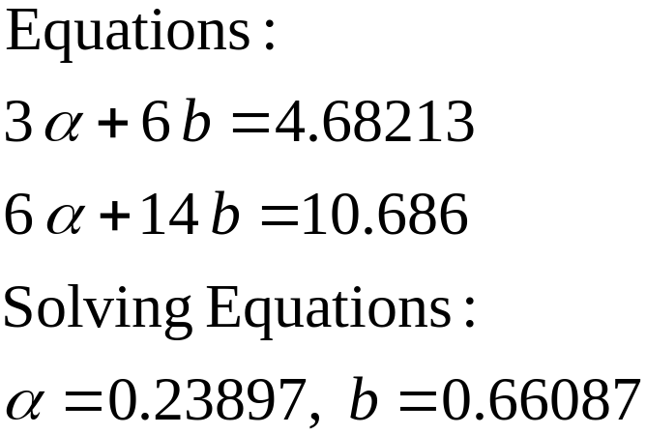
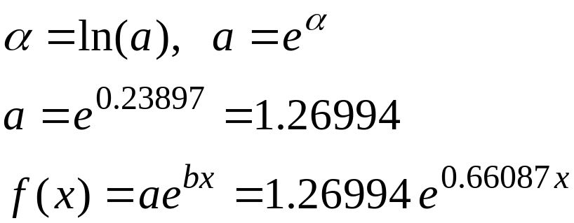
Evaluating Sums and Solving
x_{i} | 1 | 2 | 3 | ∑=6
y_{i} | 2.4 | 5 | 9
z_{i}=ln(y_{i}) | 0.875469 | 1.609438 | 2.197225 | ∑=4.68213
x_{i}² | 1 | 4 | 9 | ∑=14
x_{i} z_{i} | 0.875469 | 3.218876 | 6.591674 | ∑=10.6860
CISE301_Topic4

